Slide 1

Lecture 8: JavaScript DOM
Open Source Web Software

Slide 2
In the Last Lecture
JavaScript Features
Interpreted language
Dynamic typing
Functional programming (like C Language)
Object oriented programming (like C++ or Java)
JavaScript is a scripting language and it is not Java
It is easy to learn
Location of JavaScript
External JavaScript
Inner JavaScript
Inline JavaScript

Slide 3
In the Last Lecture
JavaScript Syntax
JavaScript Output
JavaScript Statement
JavaScript Comments
JavaScript Variable
JavaScript Operators
JavaScript Data Types
JavaScript Function
JavaScript Strings
JavaScript Numbers
JavaScript Arrays
JavaScript Controls
JavaScript Loops

Slide 4
Table of Contents
Part 1.
JavaScript DOM
Part 2
JavaScript Practice

Slide 5
Javascript DOM
Part 1

Slide 6
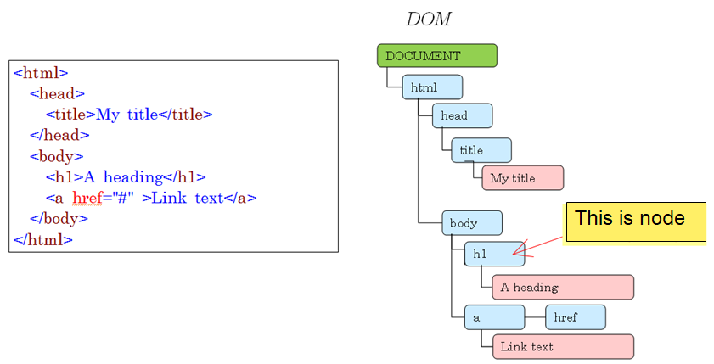
JavaScript DOM
What is DOM (Document Object Model)?
DOM represents a hierarchical structure of an HTML document as a tree

Slide 7
JavaScript DOM
JavaScript can utilize the DOM to make dynamic pages
JavaScript can change all the HTML content in the page
JavaScript can change all the HTML elements and attributes in the page
JavaScript can change all the CSS styles in the page
JavaScript can add new HTML elements and attributes
JavaScript can remove existing HTML elements and attributes
JavaScript can react to all existing HTML events in the page
JavaScript can create new HTML events in the page

Slide 8

JavaScript DOM
Document
When an HTML document is loaded into a web browser, it becomes a document object
The document object is the root node of the HTML document

Slide 9
JavaScript DOM
Method
Actions you can perform on HTML Elements
Like adding or deleting an HTML element
Property
Values that you can get or change
Like changing the content of an HTML element
Document, Methods and Property Example
document.getElementById("demo").innerHTML = "Hello World!";
Here, getElementById is a method, while innerHTML is a property

Slide 10
JavaScript DOM
Find and access HTML elements in the page
There are several ways to do this
Finding HTML elements by id
getElementById
Finding HTML elements by tag name
getElementsByTagName
Finding HTML elements by class name
getElementsByClassName
Finding HTML elements by CSS selectors
querySelectorAll
Other ways
document.body

Slide 11
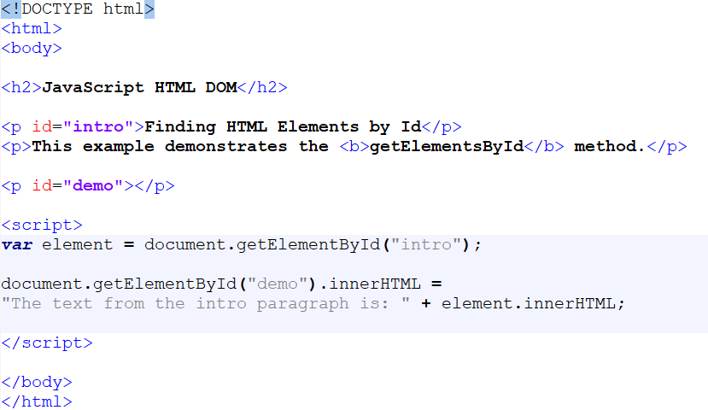
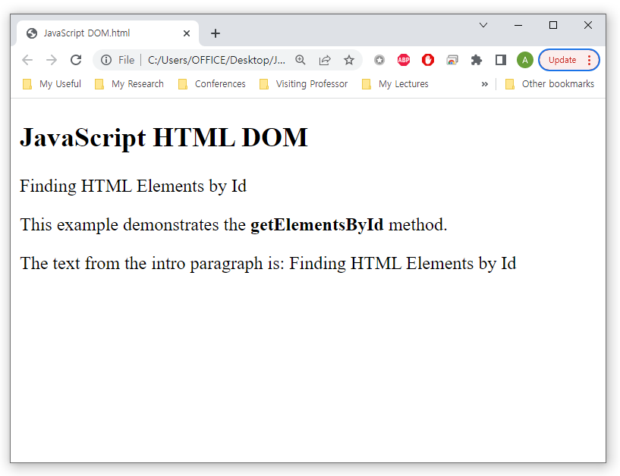
JavaScript DOM
Find and access HTML elements in the page
Finding HTML elements by id

Slide 12
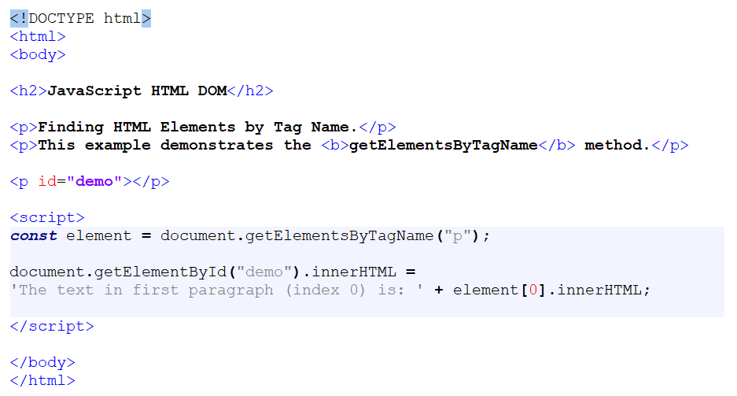
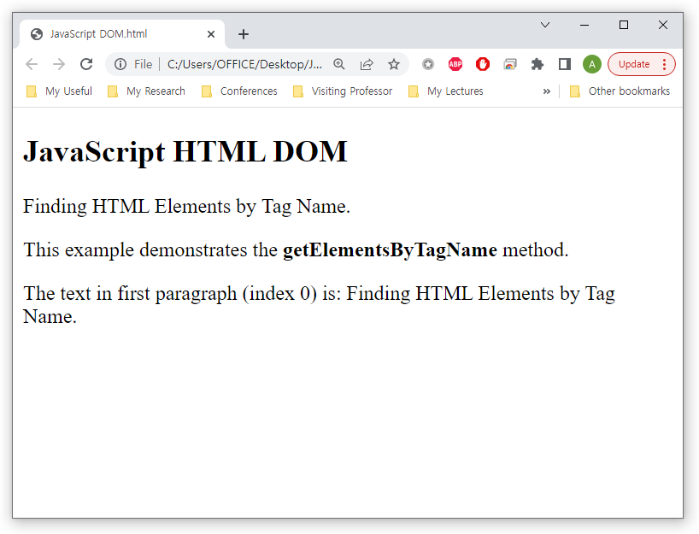
JavaScript DOM
Find and access HTML elements in the page
Finding HTML elements by tag name

Slide 13
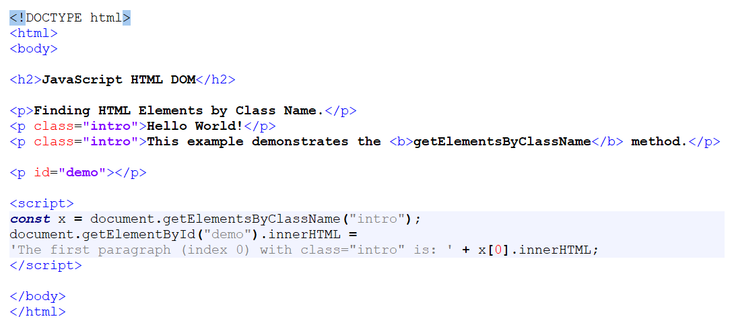
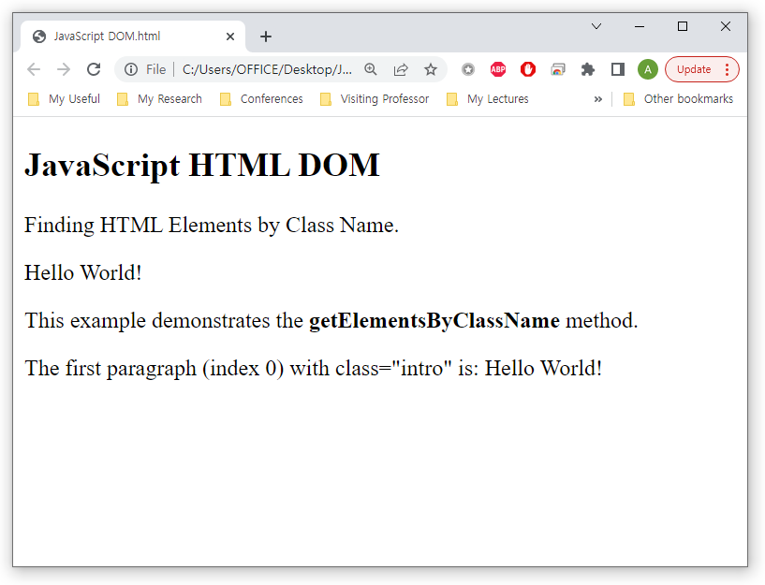
JavaScript DOM
Find and access HTML elements in the page
Finding HTML elements by class name

Slide 14
JavaScript DOM
Find and access HTML elements in the page
getElementsByTagName() and getElementsByClassName() methods return an HTMLCollection object
HTMLCollection object is an array-like list (collection) of HTML elements
You can use length property with HTMLCollection
myCollection.length
You can also loop through the list of HTMLCollection
HOWEVER! HTMLCollection is not an array
You cannot use array methods like valueOf(), pop(), push(), or join() on an HTMLCollection

Slide 15
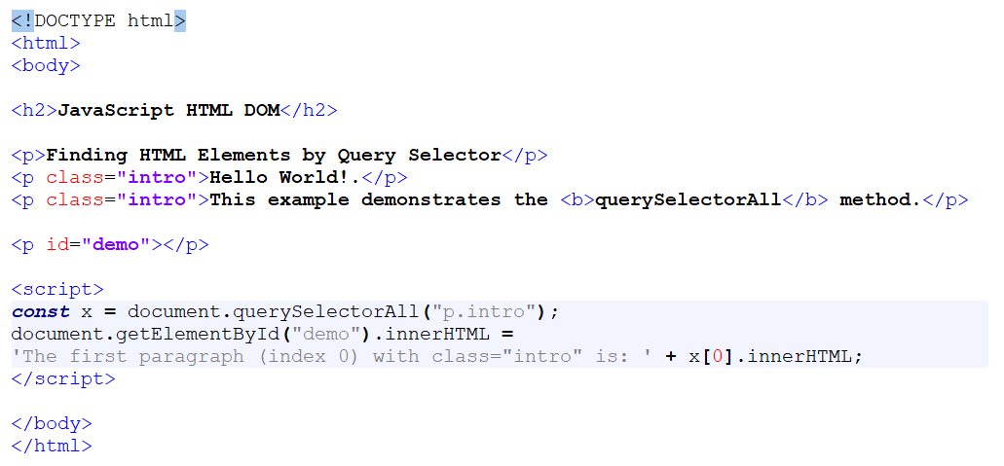
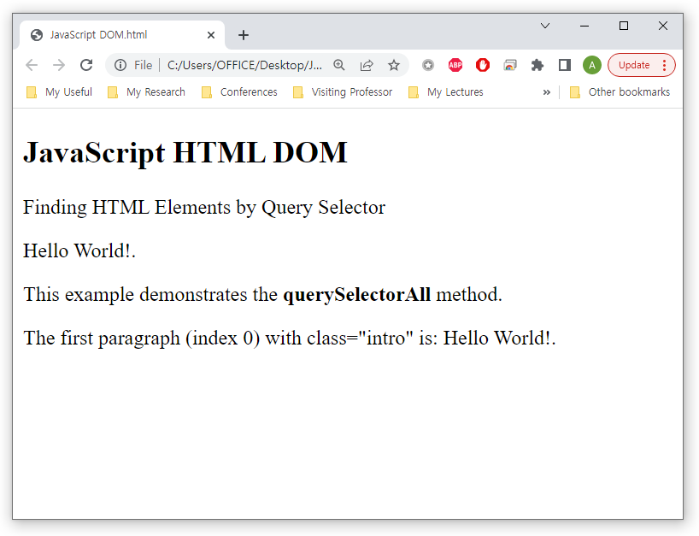
JavaScript DOM
Find and access HTML elements in the page
Finding HTML elements by CSS selectors

Slide 16
JavaScript DOM
Find and access HTML elements in the page
The querySelectorAll() method returns a NodeList
A list (collection) of nodes extracted from a document
NodeList object is an array-like list (collection) of HTML elements
Difference between HTML Collection and NodeList
HTMLCollection
A collection of document elements
Items can be accessed by their name, id, or index number
NodeList
A collection of document nodes (element nodes, attribute nodes, and text nodes)
NodeList items can only be accessed by their index number

Slide 17
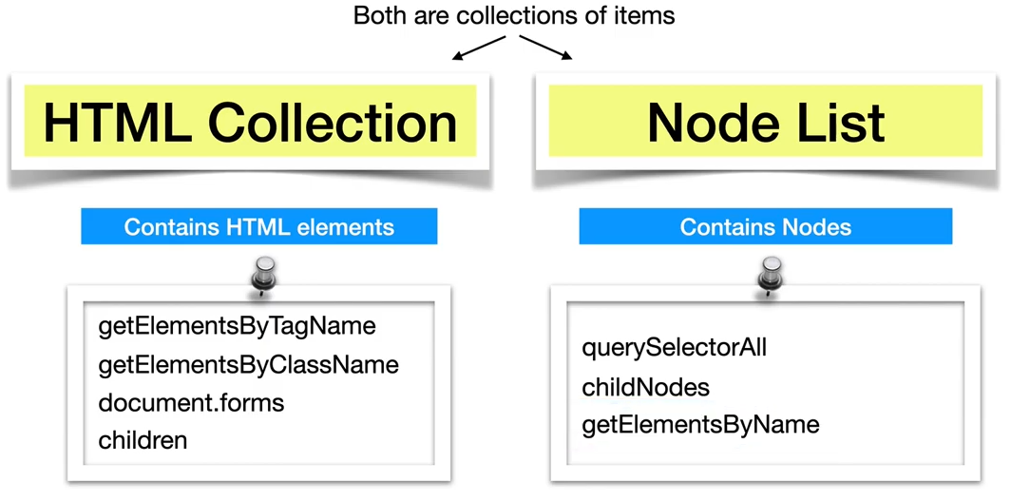
JavaScript DOM
Find and access HTML elements in the page
Difference between HTML Collection and NodeList

Slide 18
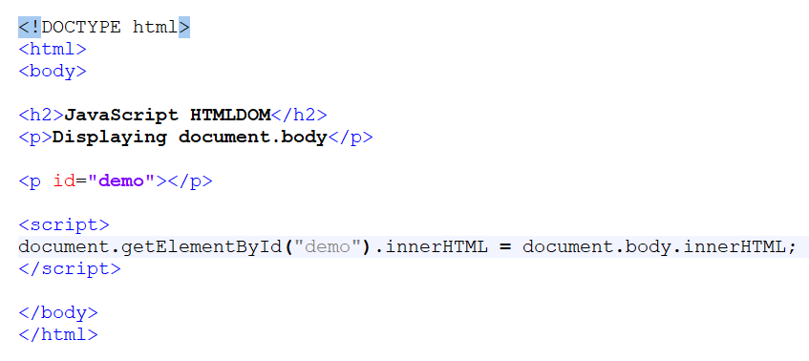
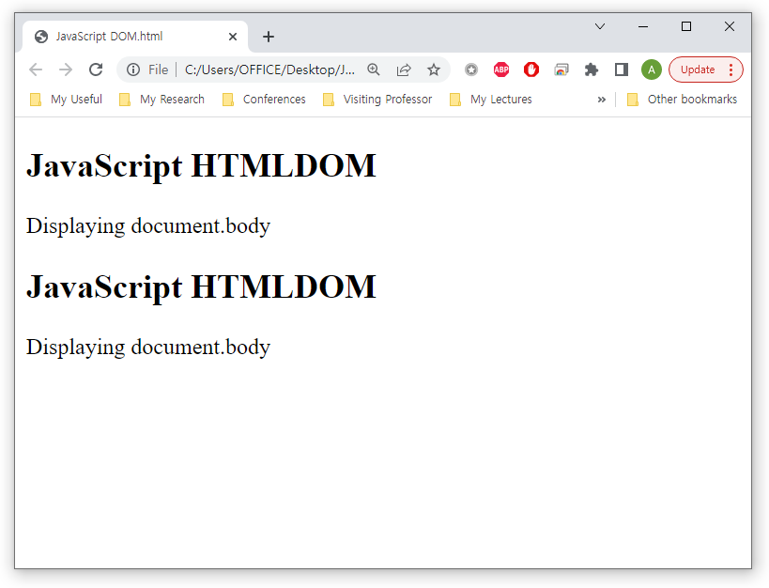
JavaScript DOM
Find and access HTML elements in the page
Other ways

Slide 19
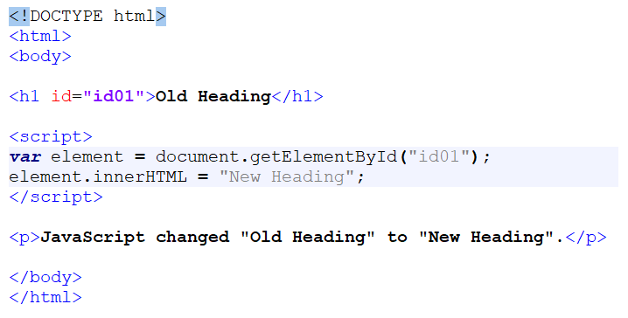
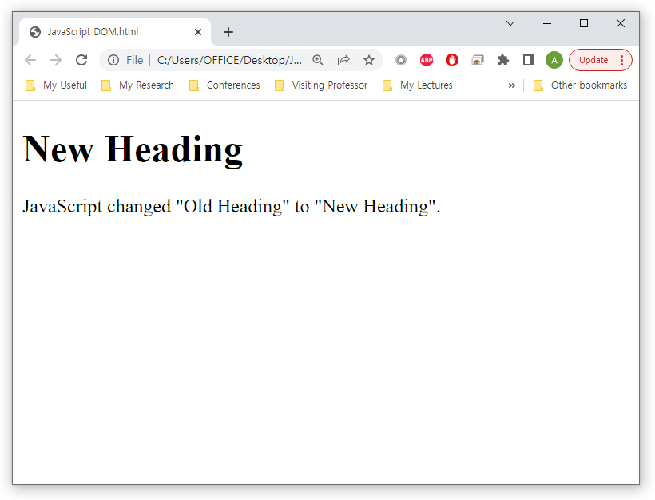
JavaScript DOM
Change the HTML content in the page
To change the content of an HTML element, use this syntax
document.getElementById(id).innerHTML = new HTML

Slide 20

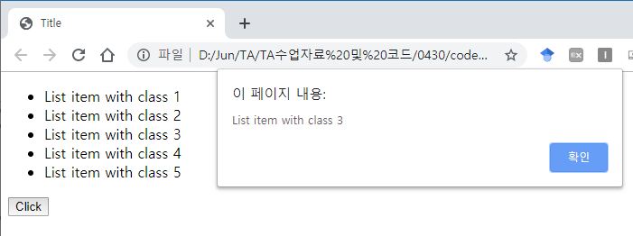
JavaScript DOM
Change the HTML content in the page
Access HTML Content

Slide 21
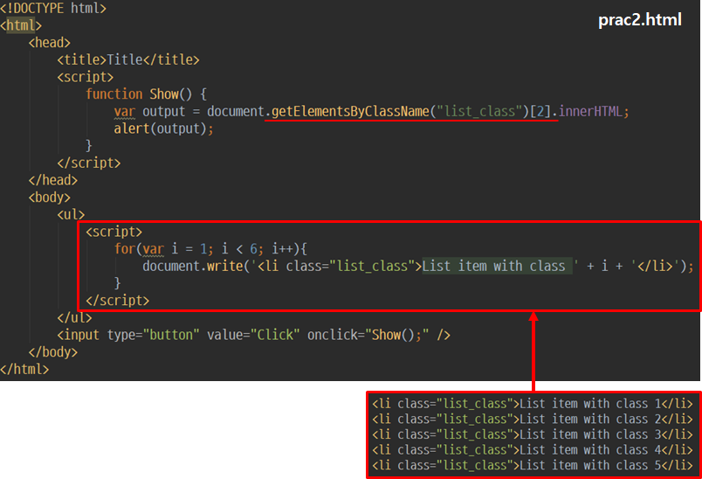
JavaScript DOM
Change the HTML content in the page
Access HTML Content

Slide 22
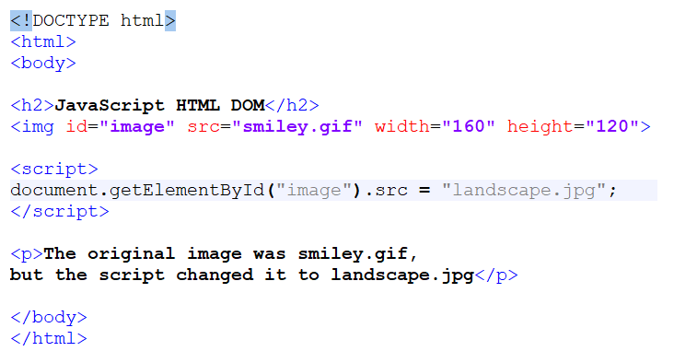
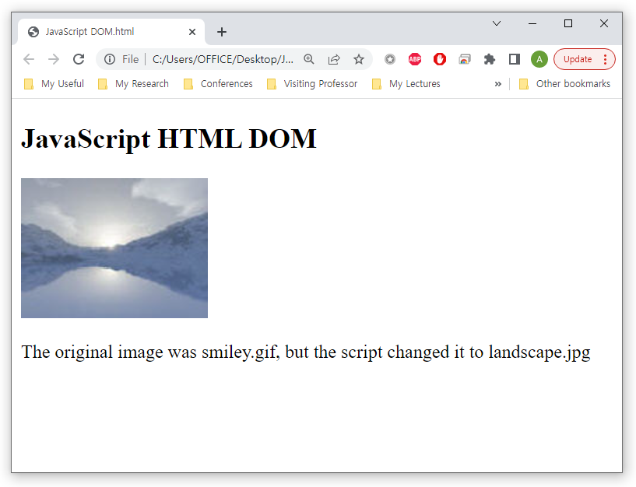
JavaScript DOM
Change all the HTML elements and attributes in the page
To change the value of an HTML attribute, use this syntax:
document.getElementById(id).attribute = new value

Slide 23
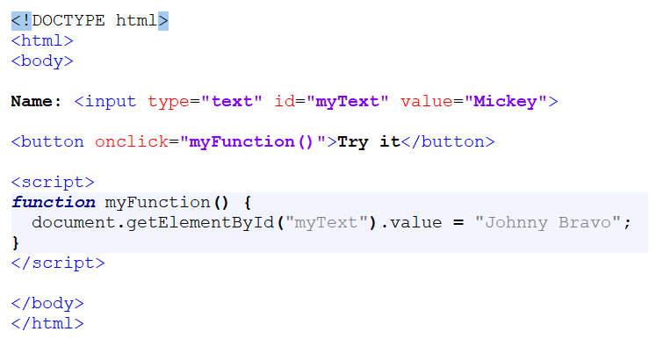
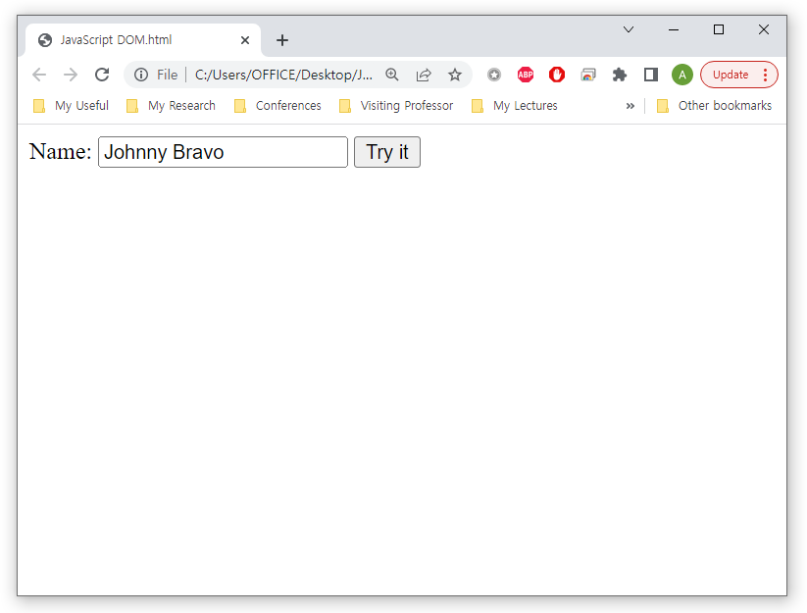
JavaScript DOM
Change all the HTML elements and attributes in the page
To get the value of an HTML form, use this syntax:
document.getElementById(id).value = new value

Slide 24
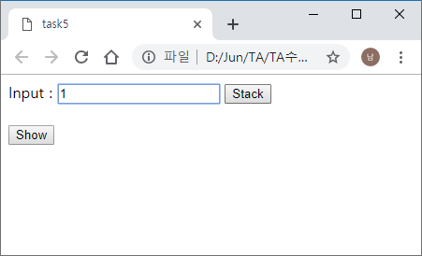
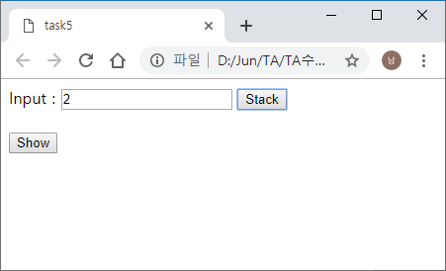
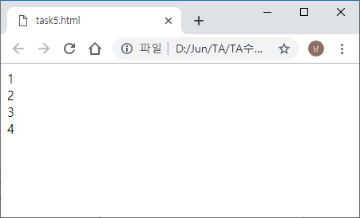


JavaScript DOM
Change all the HTML elements and attributes in the page
More examples
When the “Stack” button is clicked, store the value in the array
When the “Show” button is clicked, show the value of the array

Slide 25
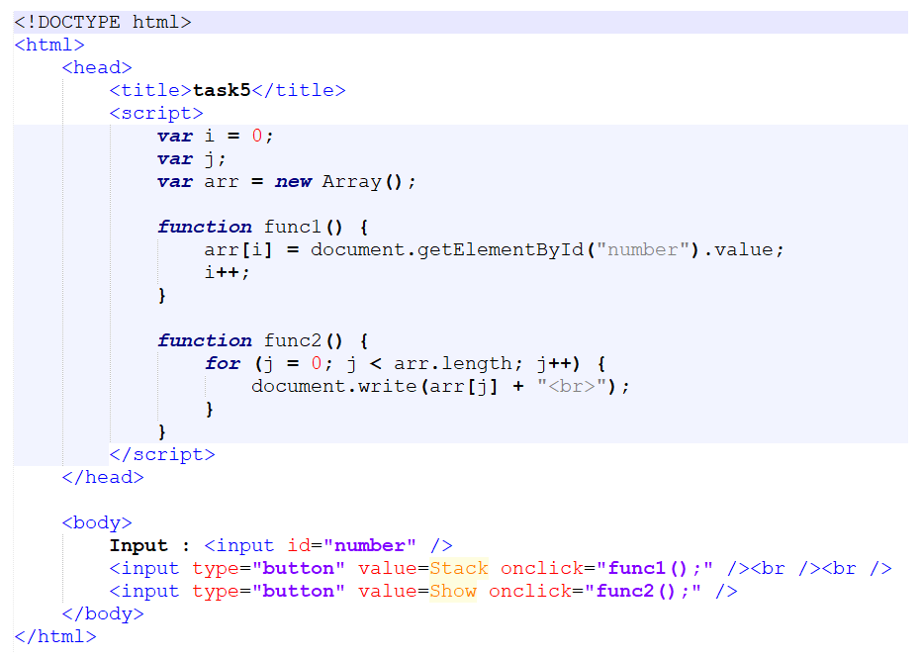
JavaScript DOM
Change all the HTML elements and attributes in the page
More examples

Slide 26
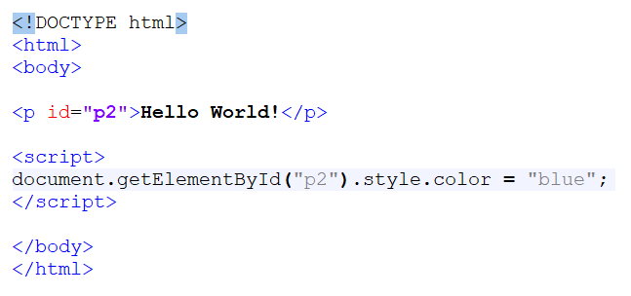
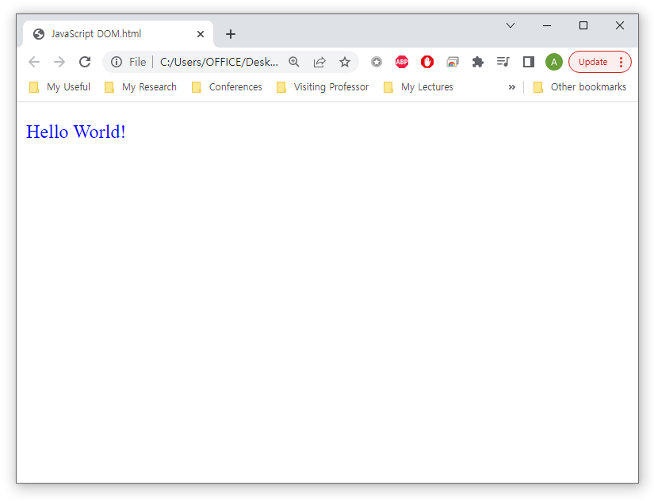
JavaScript DOM
Change the CSS styles in the page
To change the style of an HTML element, use this syntax
document.getElementById(id).style.property = new style;

Slide 27
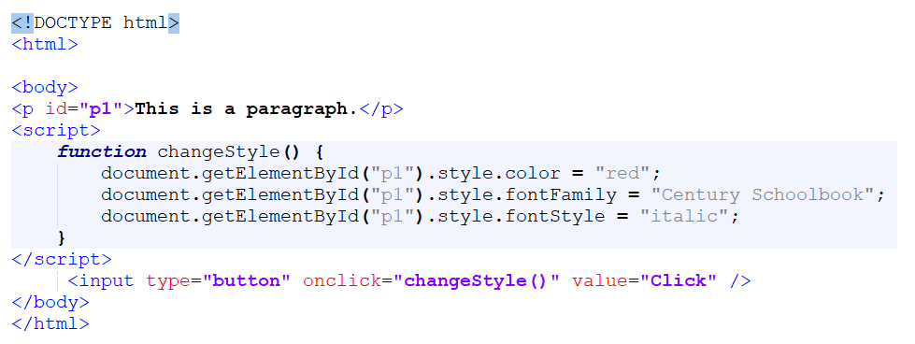
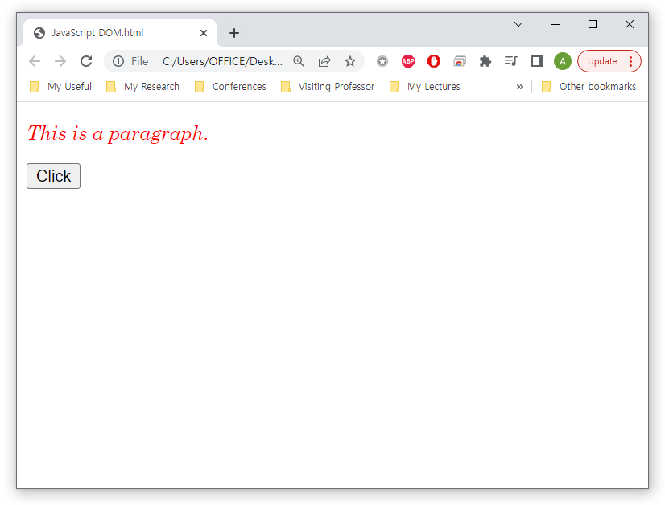
JavaScript DOM
Change the CSS styles in the page
You can also change the CSS style when an event occurs
For example, an element is clicked on

Slide 28
JavaScript DOM
Change the CSS styles in the page
Task: What do these codes perform?
document.getElementById("myDIV").style.display = "none";
document.getElementById("myDIV").style.position = "absolute";
Full list of CSS style properties
https://www.w3schools.com/jsref/dom_obj_style.asp

Slide 29
JavaScript DOM
Adding and Deleting Elements
document.createElement(element)
Create an HTML element
document.removeChild(element)
Remove an HTML element
document.appendChild(element)
Add an HTML element
document.replaceChild(new, old)
Replace an HTML element

Slide 30
JavaScript DOM
Adding and Deleting Elements
Useful properties when adding and deleting elements
The children property
The firstElementChild Property
The lastElementChild Property
The nextElementSibling Property
The previousElementSibling Property
The childElementCount Property
The childNodes Property

Slide 31
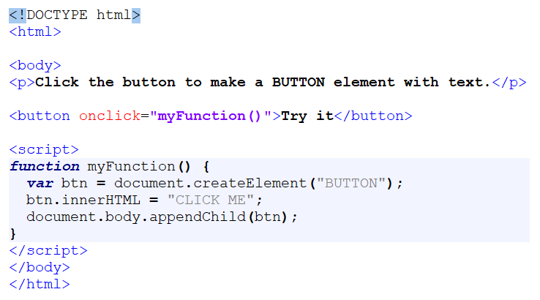
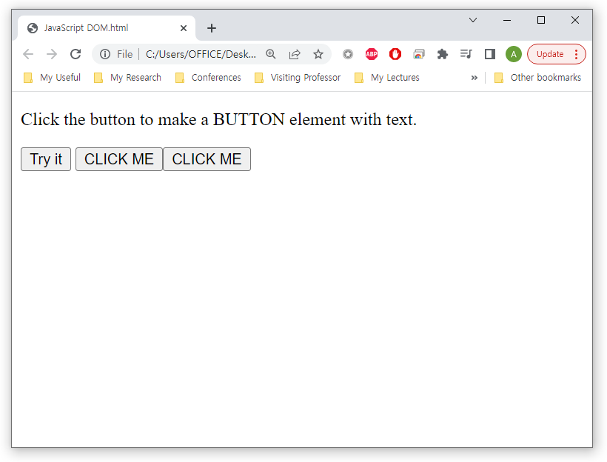
JavaScript DOM
Adding and Deleting Elements
document.createElement(element) & document.appendChild(element)

Slide 32
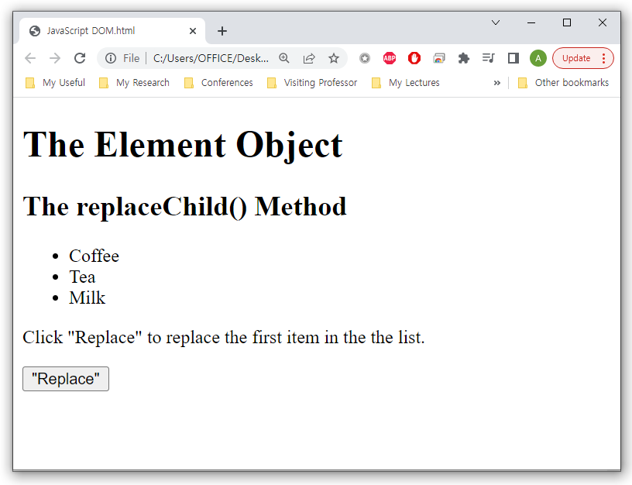
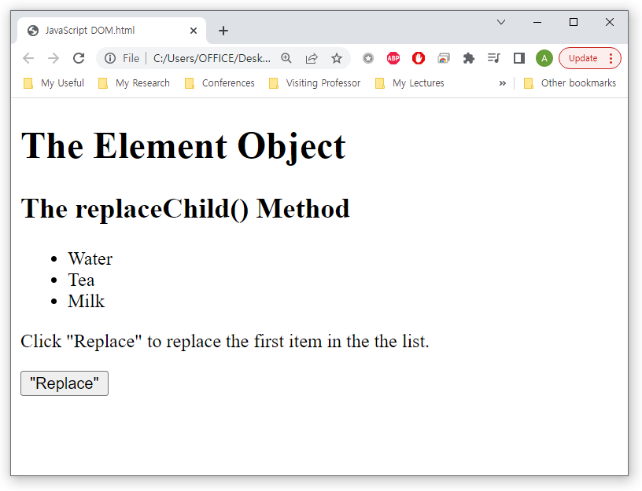
JavaScript DOM
Adding and Deleting Elements
document.replaceChild(new, old)

Slide 33
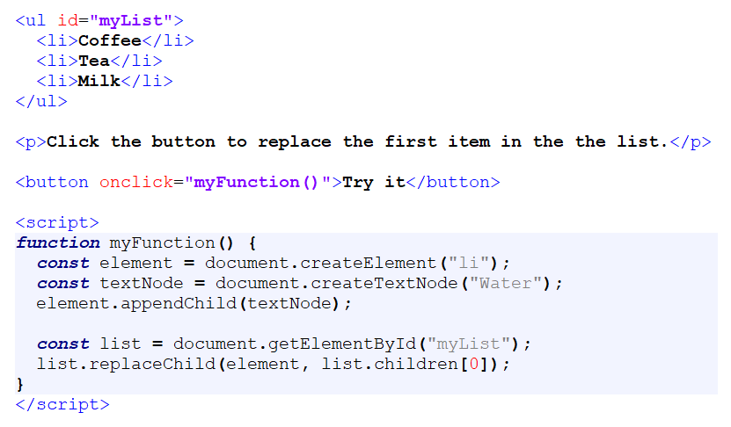
JavaScript DOM
Adding and Deleting Elements
document.replaceChild(new node, old node)

Slide 34
JavaScript DOM
Events
A JavaScript can be executed when an event occurs
Types of events
When a user clicks the mouse
When a web page has loaded
When an image has been loaded
When the mouse moves over an element
When an input field is changed
When an HTML form is submitted
When a user strokes a key

Slide 35
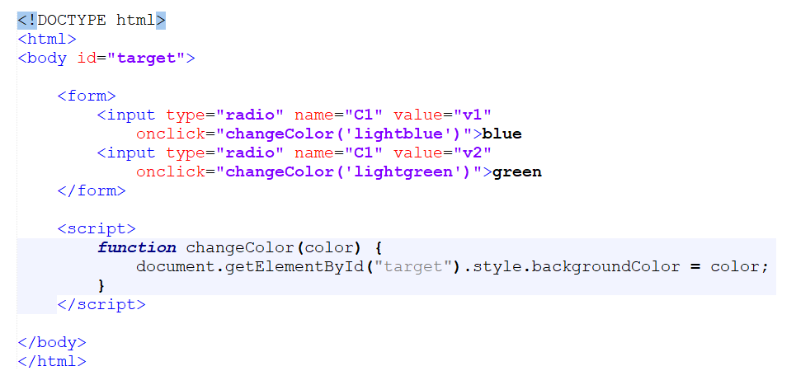
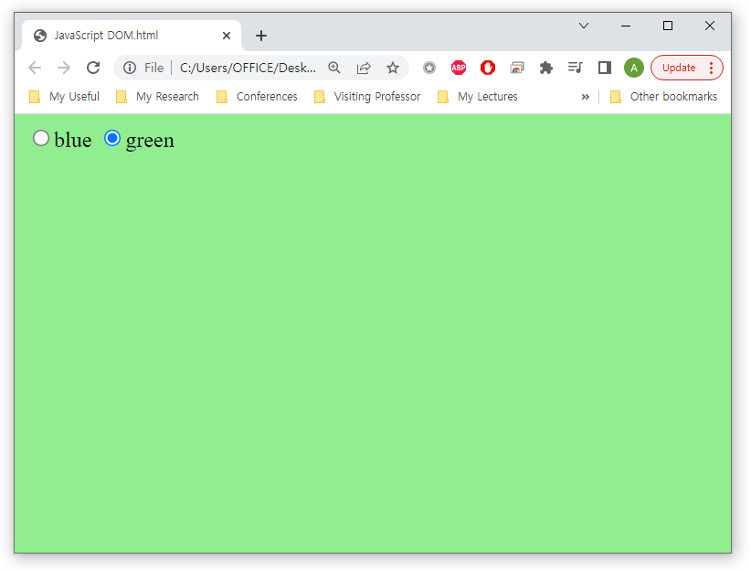
JavaScript DOM
Events
When a user clicks the mouse
onclick

Slide 36
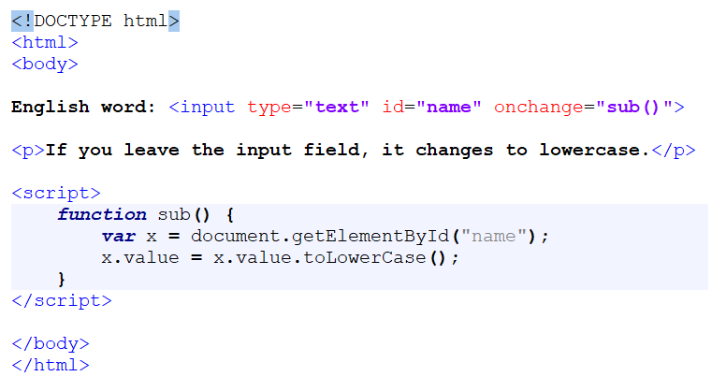
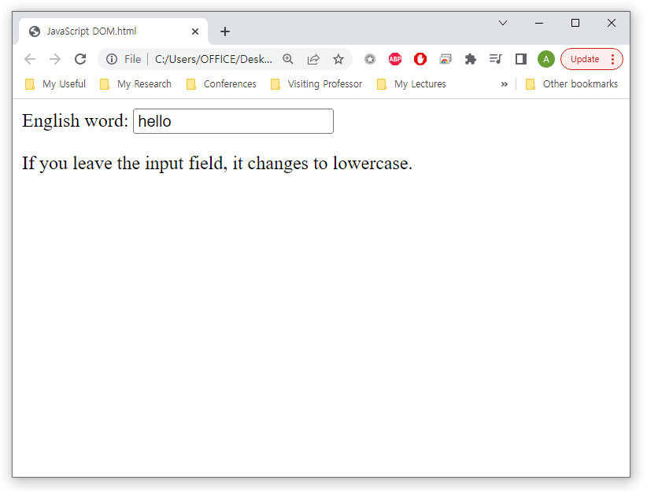
JavaScript DOM
Events
When an input field is changed
onchange

Slide 37
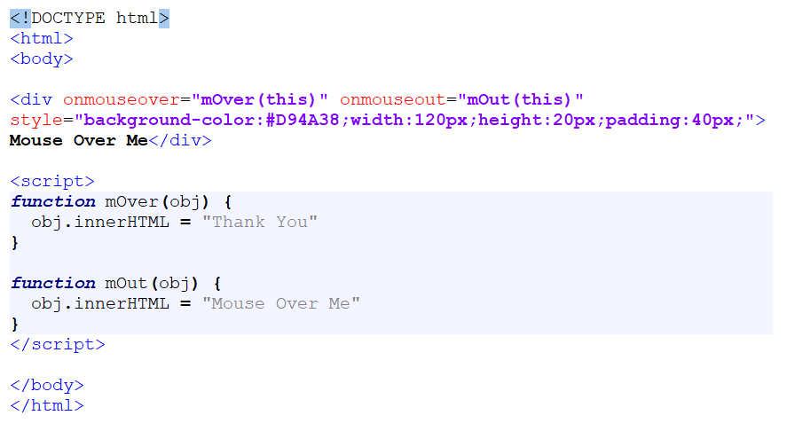
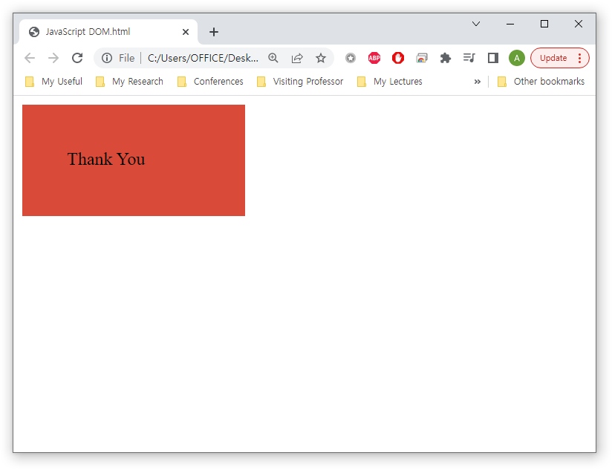
JavaScript DOM
Events
When the mouse moves over or out an element
onmouseover and onmouseout

Slide 38
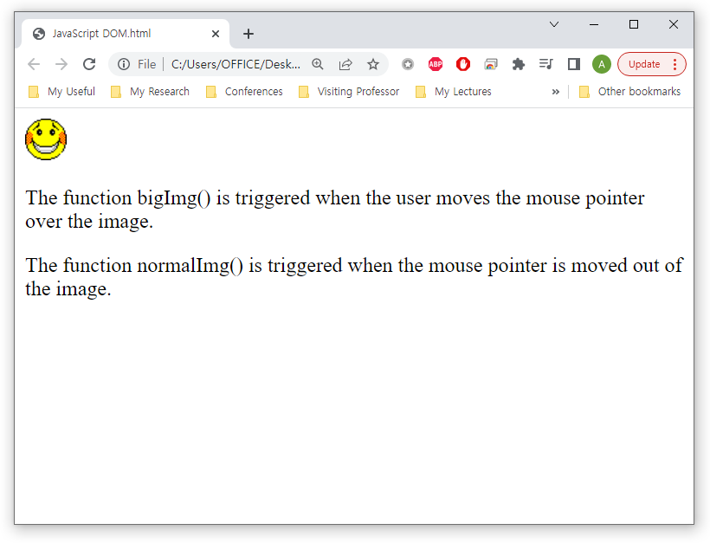
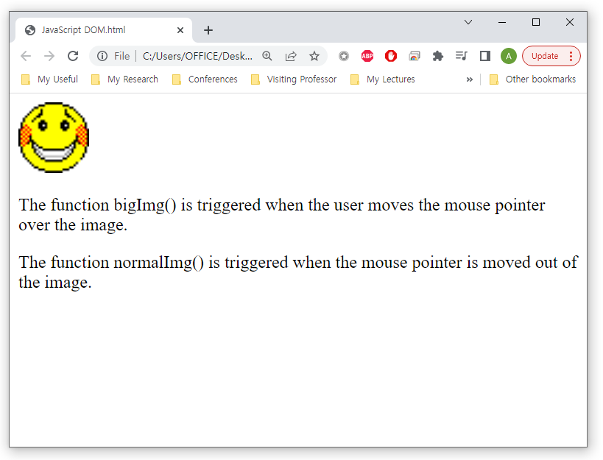
JavaScript DOM
Events
Enlarge the image when even occurs
Use onmouseover and onmouseout

Slide 39
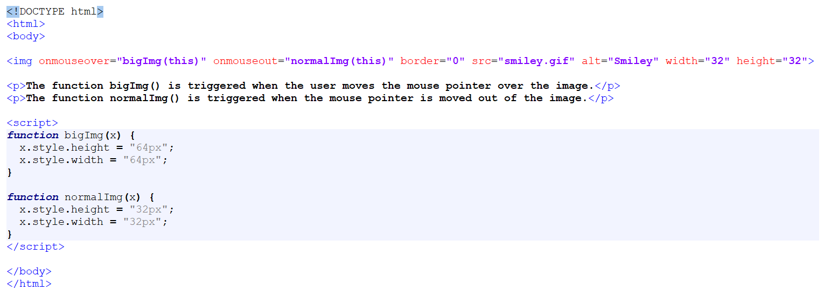
JavaScript DOM
Events
Enlarge the image when even occurs
Use onmouseover and onmouseout

Slide 40
JavaScript DOM
Events
The addEventListener() method attaches an event handler to a document
document.addEventListener(event, function, Capture)
Example
element.addEventListener("mouseover", myFunction);
element.addEventListener("click", someOtherFunction);
element.addEventListener("mouseout", someOtherFunction);
Full list of events
https://www.w3schools.com/jsref/dom_obj_event.asp

Slide 41
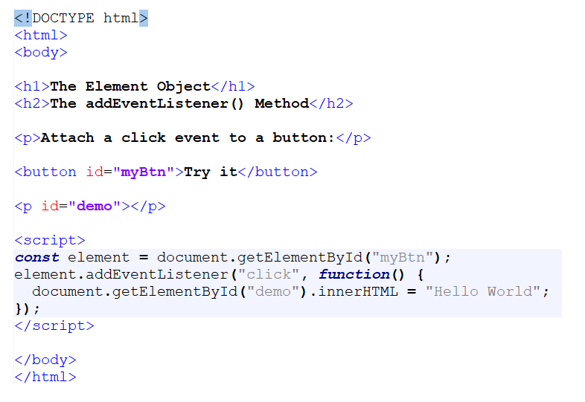
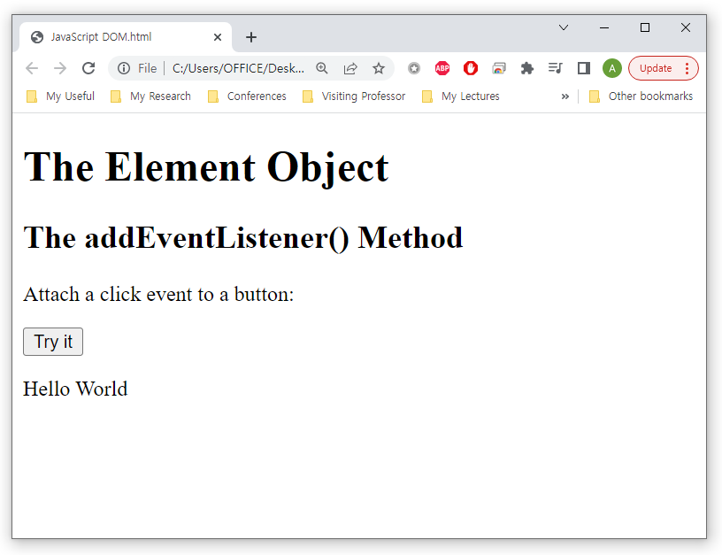
JavaScript DOM
Events
addEventListener()

Slide 42
Summary and Discussions
JavaScript can utilize the DOM to make dynamic pages
JavaScript can change all the HTML content in the page
JavaScript can change all the HTML elements and attributes in the page
JavaScript can change all the CSS styles in the page
JavaScript can add new HTML elements and attributes
JavaScript can remove existing HTML elements and attributes
JavaScript can react to all existing HTML events in the page
JavaScript can create new HTML events in the page

Slide 43
See you next time!
Questions?

